Slide 1
All courses of action are risky, so prudence is not in avoiding danger (it's impossible), but calculating risk and acting decisively. Make mistakes of ambition and not mistakes of sloth. Develop the strength to do bold things, not the strength to suffer. Niccolò Machiavelli
Intro
Lessons Learned
Teamwork
Trust Yourself
Project 4 Recap
Notes:
I started this project with the card game Set because I thought it would be something fun for my daughter to play on the way to NC. Using OOP I created what I was proud to call a very dry code. Unfortunately I got stuck trying to access various parts of the object and it was my pride and tenacity that kept me from seeing that I needed to move on. This was my biggest hurdle and lesson learned.
Knowing when to move on and accepting that it’s not the same as quitting is a quality I’m continuously learning to develop. What I didn’t expect was how attached I would become to coding. There’s a certain beauty in coding where no matter the language, you can take a series of letters, numbers, and symbols and create something functionally or aesthetically beautiful. It lets you work with both sides of the brain and marry art and logic and that allows you to become attached to your work. To that end, detaching myself from code that wasn’t working felt like a disservice. Yet I learned that in doing that, I enable myself to create something better.
Collaboration with my team mates was integral to my success. I found myself at my wits’ end with the code for Set, but I didn’t know any other games and felt overwhelmed by trying to code without understanding the logic. It was Sean who dumbed it down for me by telling me that Whack a Mole was just using a lot of divs. And it was Emily who helped me debug by guiding me without giving the answers away so I could figure it out for myself.
Trust what you know even if you think you don’t know it seems to be a common theme, but it’s true. For instance, for most of this training I relied on external libraries like Bootstrap and NPM to make styling and functionality easier. It wasn’t until I had nearly completed styling this project that I realized the only library used was jQuery. Using a CSS library would have made things like responsiveness easier, but I wouldn’t have learned how to make CSS and jQuery media queries, and I would’ve spent so much time overwriting another library’s styles. This is also my first project using jQuery and I think both of these are huge accomplishments. It was like the old yellow pages commercial where I let my fingers do the walking and things worked.
While I decided to build Whack a Mole, I knew I couldn’t build the traditional game. What started as a joke about using insurance mascots instead of moles became an actual game of Whack the Competition which is what I will be presenting. The game is fully functional, but there is room for improved logic and tweaks to styling. Stretch goals.
…..demo game

Slide 2
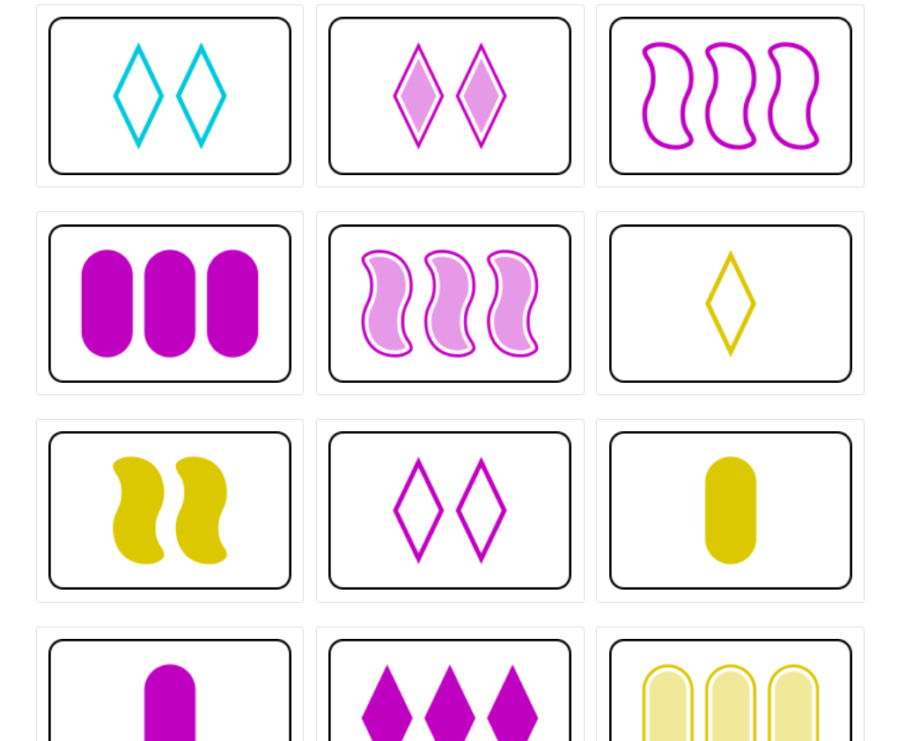
Intro
Always code as if the guy who ends up maintaining your code will be a violent psychopath who knows where you live.
- John Woods

Slide 3
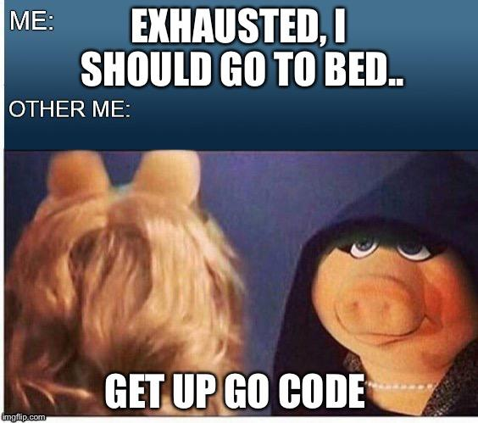
Lessons Learned
“Do not be attached to code because of how much effort you put into it. Bad code needs to be discarded.”

Slide 4
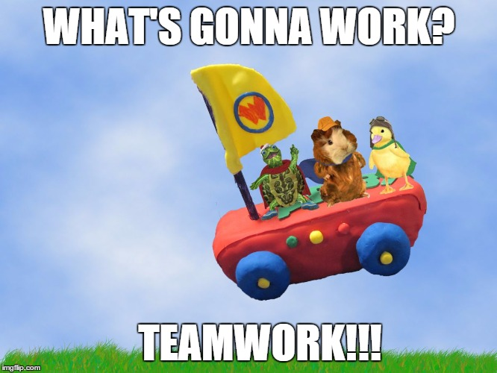
Teamwork
“In programming, one is the loneliest number.”

Slide 5

Trust Yourself
“The most dangerous thought that you can have as a creative person is to think that you know what you’re doing.”
- Bret Victor

